Slide 1
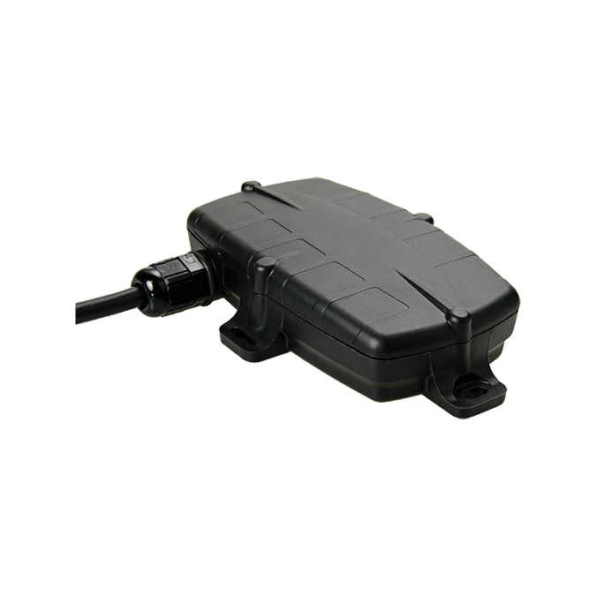
G70
Wired, IP67 Rated, Compact GPS Asset Tracker
The G70 is a tracking device for vehicles, trailers, and industrial equipment of any manufacturer.
FEATURES
4G Cat-M1 modem for GPS location
IP67 water- and dust-proof
Connection to high-precision GNSS (GPS/GLONASS/Galileo)
Flash memory for backup data collection if machine goes out of range
Internal battery for backup power
Low-profile design
Durable, tamper-proof casing
Mounting tabs for easy installation
BENEFITS
High-precision location data empowers efficient asset management.
Runtime, route, and distance logs enable cost-saving analyses.
Recovery Mode can be remotely activated for second-by-second location data to find missing equipment.
SIMPLY EFFECTIVE
Track vehicle and equipment runtime.
Locate equipment.
Log routes and distances travelled.
Ensure data is never lost. with backup battery and
flash memory.
Protect equipment from theft.

Slide 2
MECHANICAL SPECIFICATIONS
Low-profile IP67 durable casing | Case was recently updated after customer feedback and extensive testing. Made of ultra-tough nylon glass to survive bumps, knocks, and years in the sun and weather. Reinforced in key areas around the mounting and screw holes to prevent breakage. IP67 dust- and water-proof. Mounting tabs for easy installation.
Dimensions | L 126 x W 80 x H 27mm
Operating Temperature | -20°C to +60°C (connected to external power) The battery will not charge when its temperature is <0°C or > +40°C. Charging batteries at extreme temperatures damages the battery and can cause accident or injury.
POWER
Input Voltage | 8-36V DC (max)
Operating Current | LTE-M / NB-IoT ≈50mA when moving + ≈60mA while internal battery charging
Backup Battery | 1100mAh LiPo internal backup battery pack
Intelligent Power Management | Device enters sleep mode when vehicle is inactive to prevent battery drain.
Sleep Current | <1mA
OTHER
Flash Memory | Memory capacity to store more than 10 days of continuous 30-second logging or many weeks of less-frequent logging. Normally data is immediately sent to the server, but if the device is out of range there is memory space to ensure no data is lost.
Installation | 10-wire harness 1m length
Ignition | Dedicated ignition digital input 0-48V DC with 2.2V on/off threshold.
Theft Recovery | Device can be remotely switched into Recovery Mode for live location tracking.
OTA Configuration | A backend portal enables remote configuration.
AES-256 Security | Bank-level AES-256 device authentication and data encryption ensure your data is kept private and secure.

